Slide 1
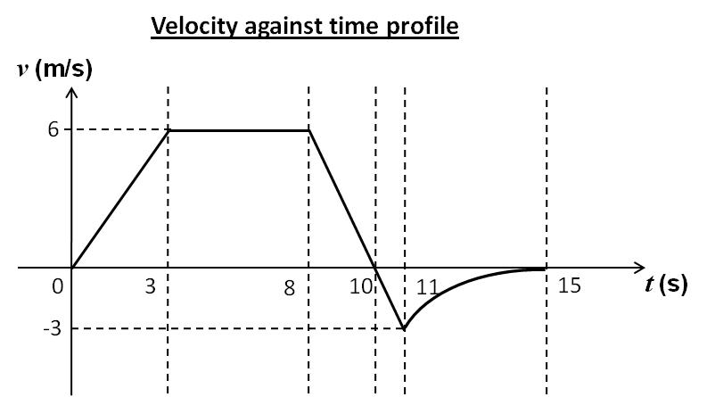
Anne and Betty were given the velocity against time profile of a moving car as shown below.

Slide 2
They each tried to sketch out the displacement against time and acceleration against time graphs for the profile of the moving car.
Upon comparison, they noticed some slight differences in their sketches for each type of graph.

Slide 3
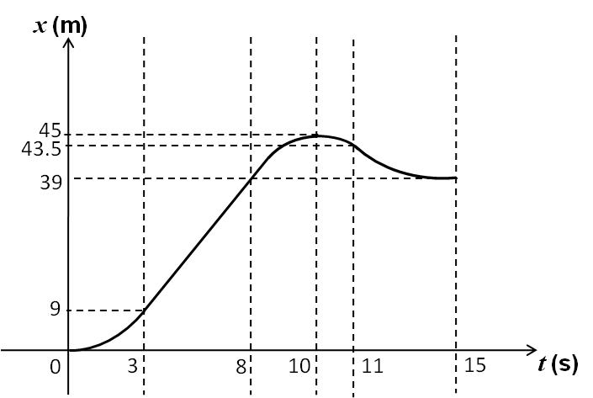
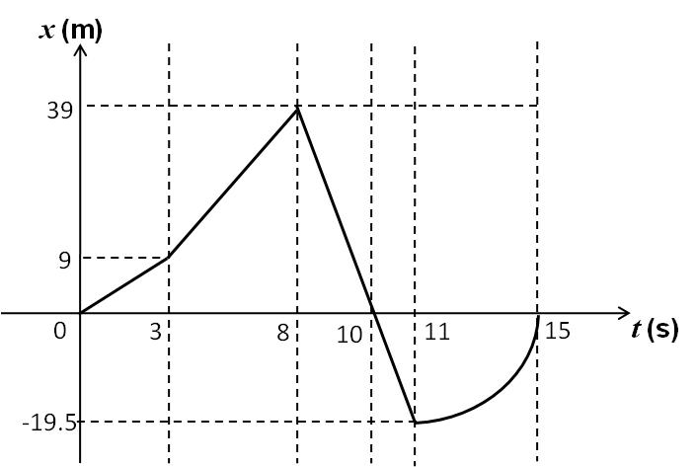
Anne’s displacement against time sketch
Betty’s displacement against time sketch

Slide 4
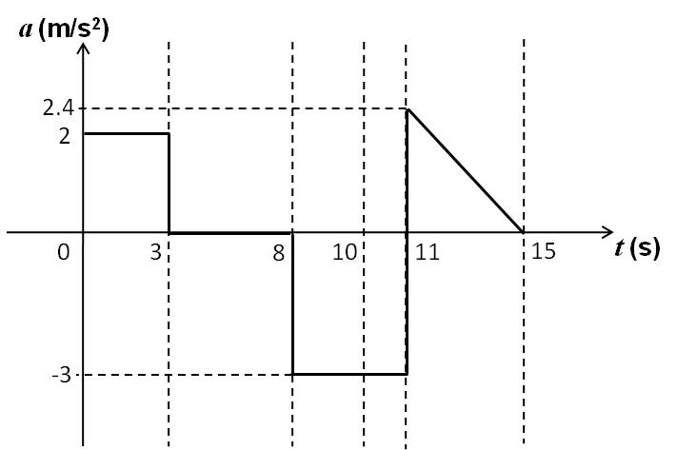
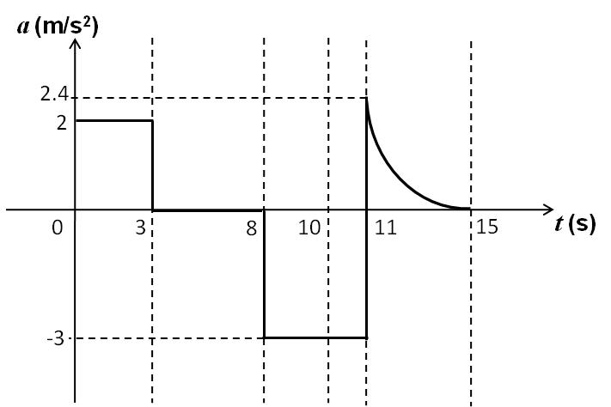
Anne’s acceleration against time sketch
Betty’s acceleration against time sketch

Slide 5
Your challenge
for the day!
List down the characteristics of the graphs which will affect your choice of the correct sketches.
Based on the above, identify the correct sketches, stating your reasons clearly.
Describe the motion of the car depicted in the respective time intervals based on the sketches you have selected.
Explain the shape of the sketches that you have selected based on the velocity against time profile for the entire journey.

